Slide 1
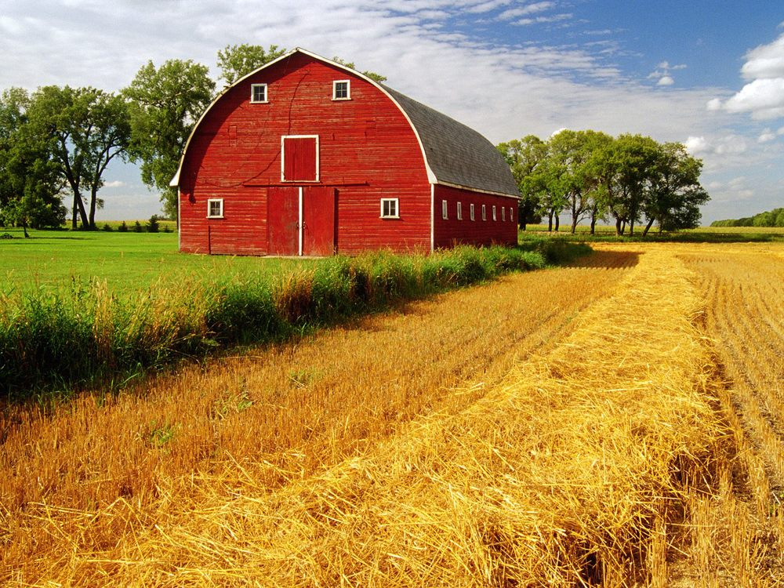
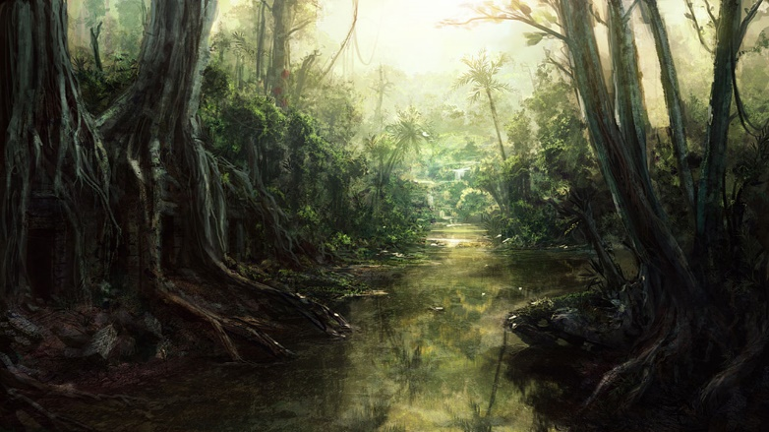
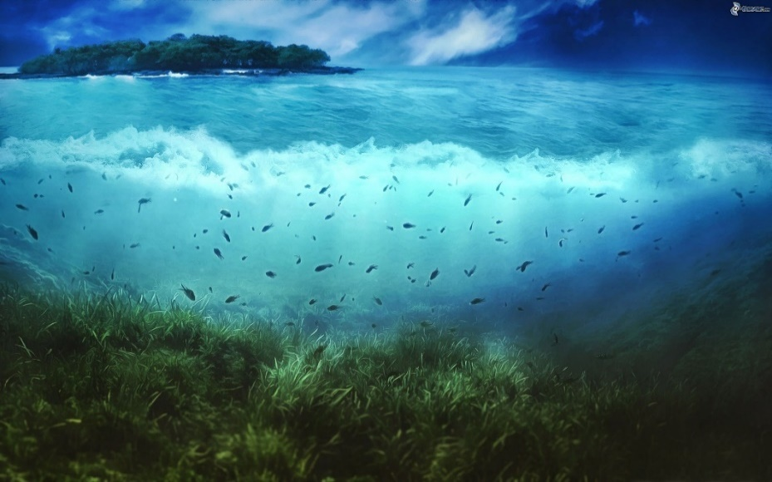
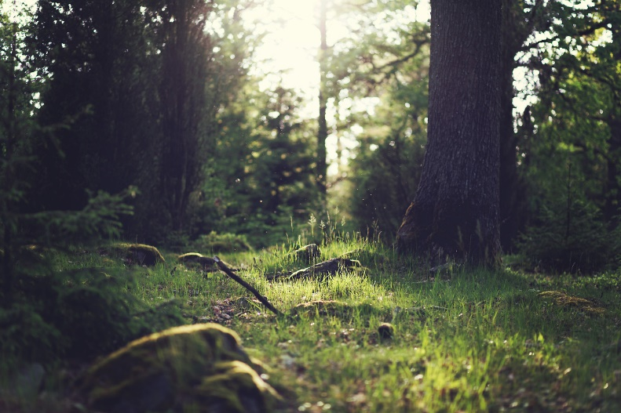
WHERE DO ANIMALS LIVE? Kje živali živijo?
IN THE JUNGLE
ON THE FARM
IN THE SEA
IN THE FOREST
Avtorica: Petra Žitko
January 2020

Slide 2
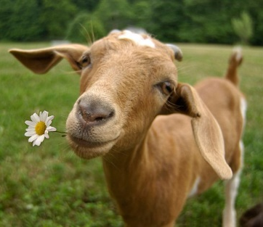
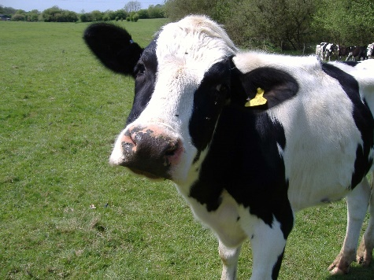
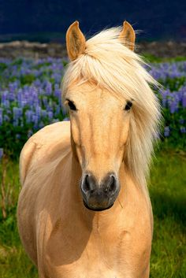
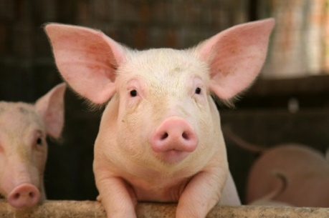
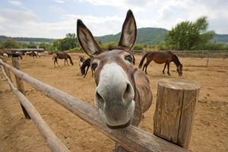
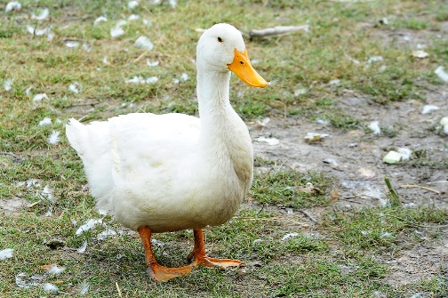
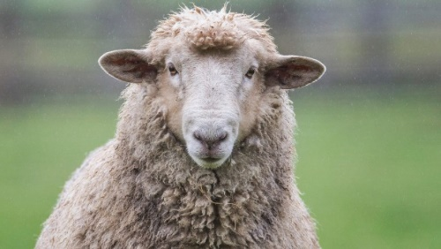
FARM ANIMALS
A GOAT
A COW
A PIG
A HORSE
A DONKEY
A SHEEP
A DUCK

Slide 3
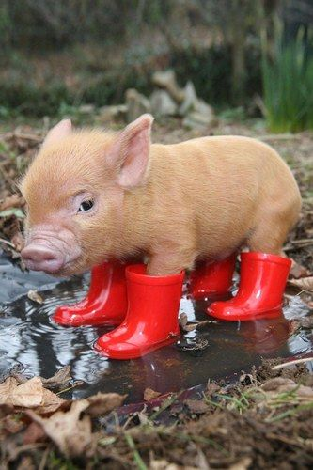
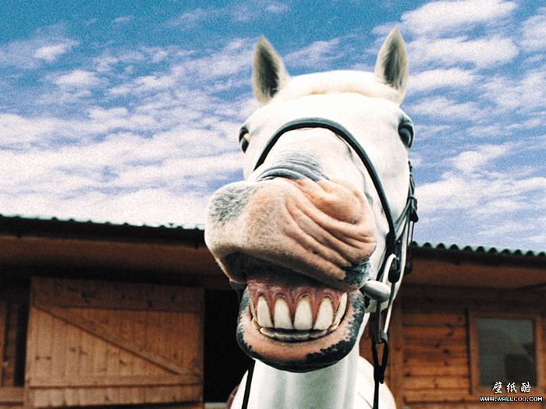
What is your favourite farm animal?
My favourite farm animal(s) is/are ________________ .

Slide 4
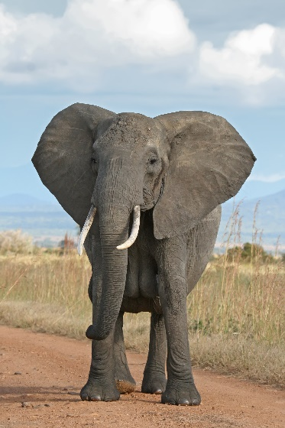
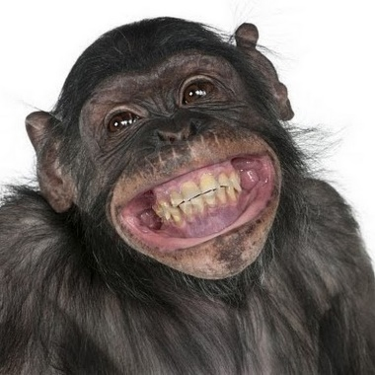
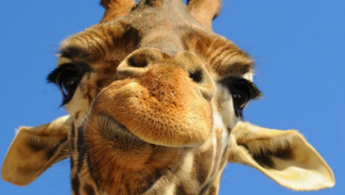
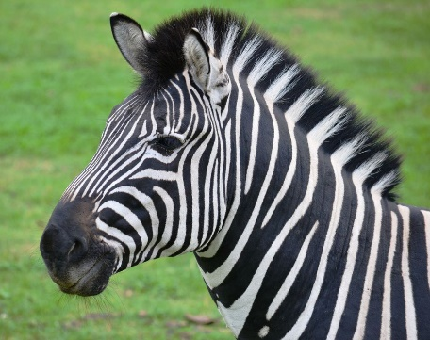
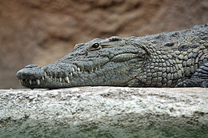
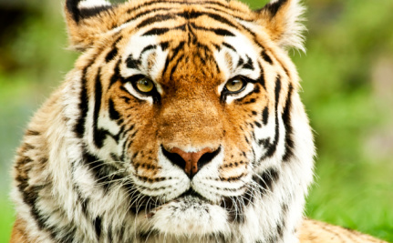
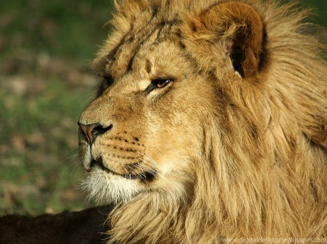
AN ELEPHANT
A MONKEY
A GIRAFFE
A ZEBRA
ZOO ANIMALS/JUNGLE ANIMALS AND WILD ANIMALS
A CROCODILE
A KANGAROO
A TIGER
A LION

Slide 5
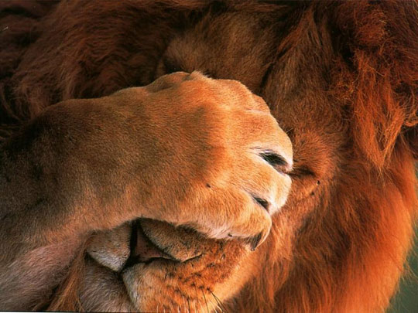
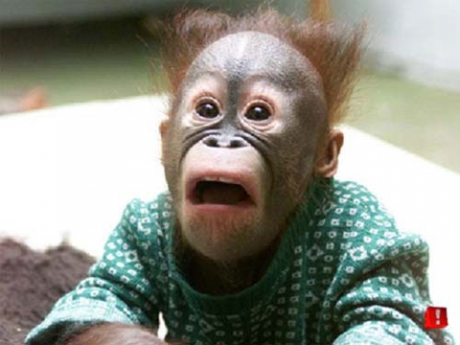
What is your favourite JUNGLE/WILD animal?
My favourite jungle/wild animal(s) is/are ________________ .

Slide 6
DO YOU LIKE MONKEYS?
(So ti všeč opice?)
YES, I DO. NO, I DON΄T.
☺ ☹

